Slide 1


Analyzing Advertising Impact on Sales: A Data-Driven Approach

Slide 2


Average amount spent on TV advertisements

Slide 3
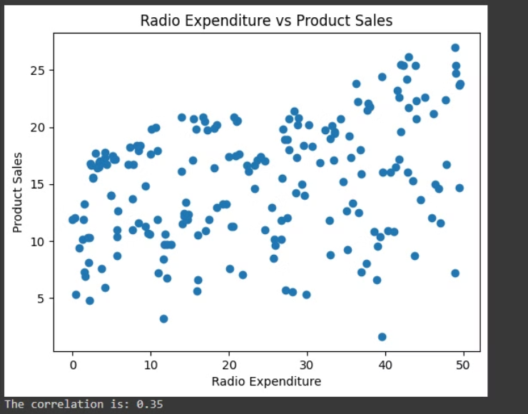
Correlation between radio advertising expenditure and product sales
The scatter plot shows that there is a positive correlation.
This implies that an increase in radio advertising expenditure leads to higher product sales.

Slide 4

Advertising medium with the highest impact on sales
Measuring Correlations: The code checks how closely related the amount spent on each type of advertising (TV, radio, newspaper) is to the product sales.
Finding the strongest correlation: After looking at the strength of these relationships, we identify which one is the strongest.

Slide 5
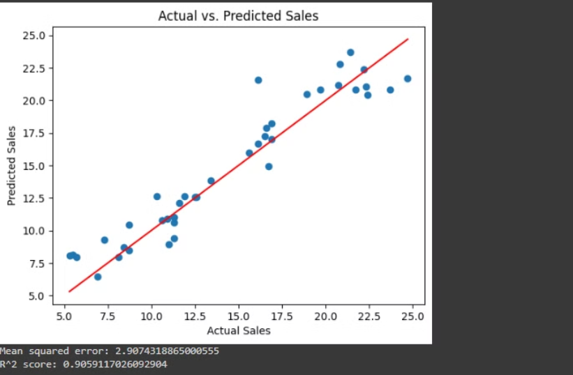
Predicting Sales with a Multi-Variable Linear Regression Model: TV, Radio, and Newspaper
Key Insights:
Strong Predictive Power: The model's sales predictions closely align with the actual observed sales data.
High R² Score: The model has an R² score of ~0.91, indicating that 91% of the variability in sales is explained by the independent variables (TV, radio, and newspaper advertising).
Low Mean Squared Error: The model has a low mean squared error of ~2.91, reflecting its high level of accuracy.
Linearity: The data points closely follow the red regression line, demonstrating a clear linear relationship between the independent variables and sales.

Slide 6

Predicting Sales Based on New Advertising Expenditures
By analyzing the data and creating a machine learning model, we are now able to predict future sales based on upcoming advertising investments. According to our model, if a company were to spend $200 on TV advertising, $40 on radio, and $50 on newspaper ads, the predicted sales would be $19.87.
This data-driven approach allows us to make more informed decisions about how to allocate advertising budgets to maximize sales. By understanding the relationship between advertising spend and sales, we can optimize our marketing mix and stay ahead of the competition.

Slide 7
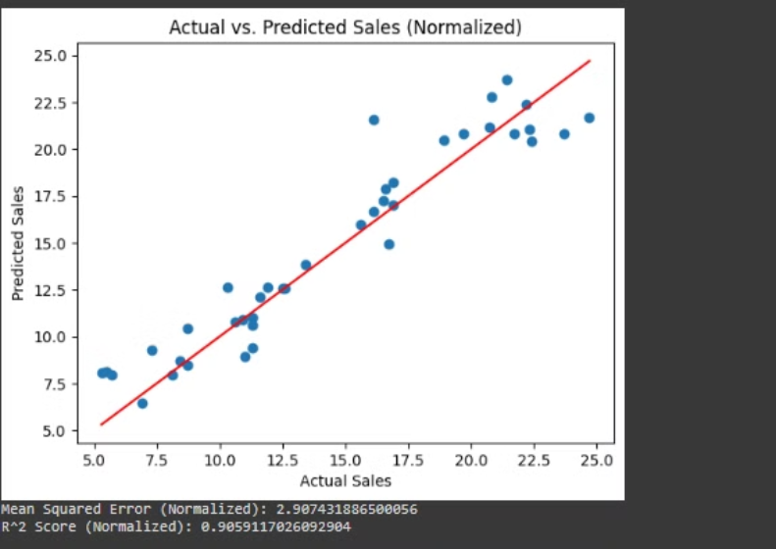
Impact of Normalization on Linear Regression Model Performance
Key Findings:
The performance metrics for the non-normalized and normalized datasets were nearly identical.
This suggests that the normalization process did not significantly impact the overall performance of the linear regression model in this particular analysis.

Slide 8
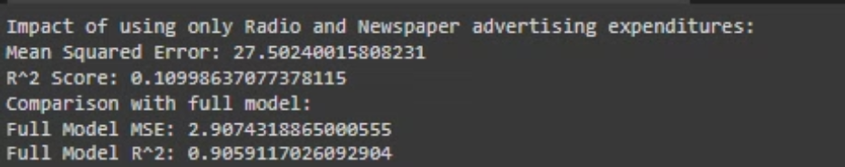
Impact of Radio and Newspaper Advertising on Sales Predictions
Performance Evaluation: The analysis examines how accurately the model predicts sales using only radio and newspaper advertising data, compared to the full model that includes TV advertising.
Findings: The predictions relying solely on radio and newspaper ad spend were slightly less accurate than the full model that incorporated TV advertising data.
Conclusion: This suggests that television advertising plays a meaningful role in predicting sales. Including TV ad data enhances the precision of the sales forecasts.

